Slide 1


Counseling Review
Tri-Service Hearing Technician
4.2 Certification Course

Slide 2
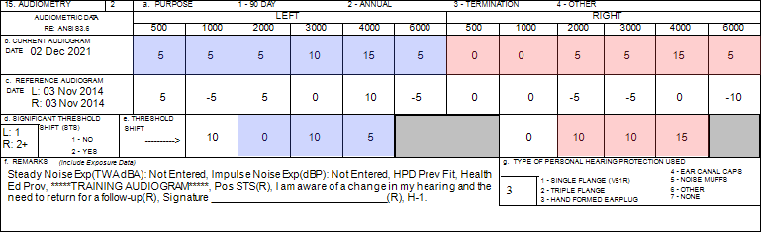
[SSN = 990990018] Confirm demographic fields 2 thru 14 (page 6)
Is there a change in hearing (ear specific)?
Are thresholds within the range of normal (ear specific)?
Where does the patient need to go?
Tri-Service Hearing Technician 4.2.0.0 Certification Course
Notes:
Do a brief review of counseling; have patient confirm their data in demographic fields 2 thru 14.
Is there a change in hearing?
Are thresholds within the range of normal?
Where does the patient need to go?
Have students write responses in their training booklet

Slide 3
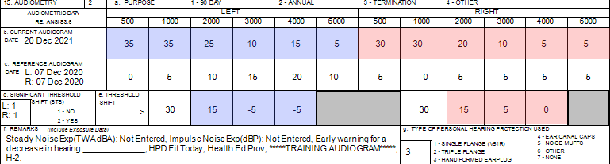
[SSN = 990990009] Confirm demographic fields 2 thru 14 (page 31)
Is there a change in hearing (ear specific)?
Are thresholds within the range of normal (ear specific)?
Where does the patient need to go?
Tri-Service Hearing Technician 4.2 Certification Course Video Next Slide
Notes:
Do a brief review of counseling; have patient confirm their data in demographic fields 2 thru 14.
Is there a change in hearing? EWS patient needs to sign DD Form 2216
Are thresholds within the range of normal? No
Where does the patient need to go? Process referral to PCM; cannot return for “follow-up” testing, can return for another annual once conductive issues resolved, especially USA/USAF due to profile change
Have students write responses in their training booklet

Slide 4
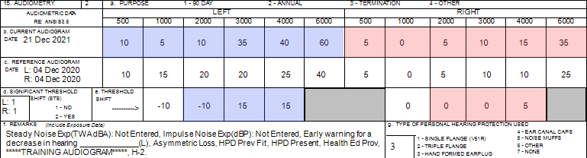
[SSN = 99099011] Confirm demographic fields 2 thru 14 (page 34)
Is there a change in hearing (ear specific)?
Are thresholds within the range of normal (ear specific)?
Where does the patient need to go?
Tri-Service Hearing Technician 4.2.0.0 Certification Course
Notes:
Do a brief review of counseling; have patient confirm their data in demographic fields 2 thru 14.
Is there a change in hearing? EWS on left ear patient needs to sign DD Form 2216
Are thresholds within the range of normal? No
Where does the patient need to go? Refer to Audiologist and/or Professional Supervisor
Have students write responses in their training booklet

Slide 5
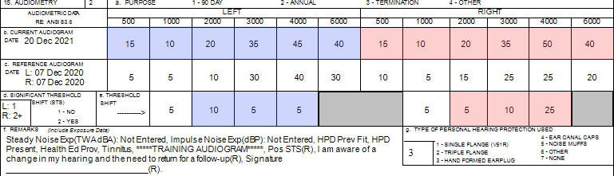
[SSN = 990990006] Confirm demographic fields 2 thru 14 (page 35)
Is there a change in hearing (ear specific)?
Are thresholds within the range of normal (ear specific)?
Where does the patient need to go?
Tri-Service Hearing Technician 4.2.0.0 Certification Course
Notes:
Do a brief review of counseling; have patient confirm their data in demographic fields 2 thru 14.
Is there a change in hearing? STS Right ear patient needs to sign DD Form 2216
Are thresholds within the range of normal? No
Where does the patient need to go? Return after 14 hours auditory rest for follow-up testing
Have students write responses in their training booklet

Slide 6
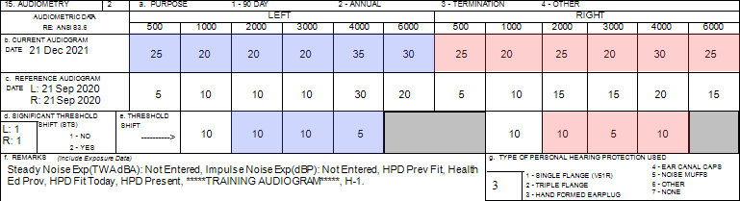
[SSN = 990990060] Confirm demographic fields 2 thru 14 (page 36)
Is there a change in hearing (ear specific)?
Are thresholds within the range of normal (ear specific)?
Where does the patient need to go?
Tri-Service Hearing Technician 4.2.0.0 Certification Course
Notes:
Do a brief review of counseling; have patient confirm their data in demographic fields 2 thru 14.
Is there a change in hearing? No
Are thresholds within the range of normal? No
Where does the patient need to go? Do otoscopic exam; Refer to PCM if abnormal
Have students write responses in their training booklet

Slide 7
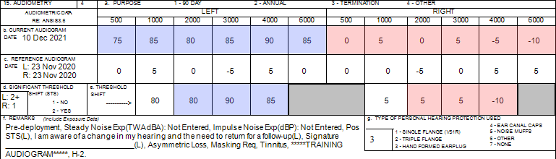
[SSN = 99099013] Confirm demographic fields 2 thru 14 (page 38)
Is there a change in hearing (ear specific)?
Are thresholds within the range of normal (ear specific)?
Where does the patient need to go?
Tri-Service Hearing Technician 4.2.0.0 Certification Course
Notes:
Do a brief review of counseling; have patient confirm their data in demographic fields 2 thru 14.
Is there a change in hearing? STS Left ear patient needs to sign DD Form 2216
Are thresholds within the range of normal? No
Where does the patient need to go? Return after 14 hours auditory rest for follow-up testing
Have students write responses in their training booklet

Slide 8
Counseling Review
? Questions ?
Tri-Service Hearing Technician
4.2 Certification Course

